Slide 1
Limitations of Augmented Virtual Teleportation (AVT) & Overcoming with solutions
By
Vimal Kumar, NIT Warangal
CS20120

Slide 2
INDEX
Sections Current Overall (Curr + Prev)
Introduction with Terminologies---------------------- 2 min 2 min
Brief discuss about AVT (Base Paper)--------------- 3 min 5 min
3. Limitation of AVT----------------------------------------- 2 min 7 min
4. Overcoming with Solutions---------------------------- 5 min 12 min
5. Demo-------------------------------------------------------- 2 min 14 min Total 14(+or-1)minutes

Slide 3
Section 1. Introduction with Terminologies Time :2 min Slide(s) : 1

Slide 4
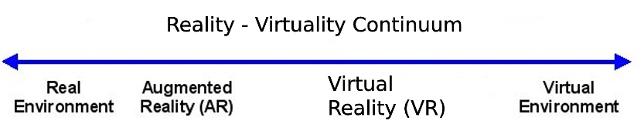
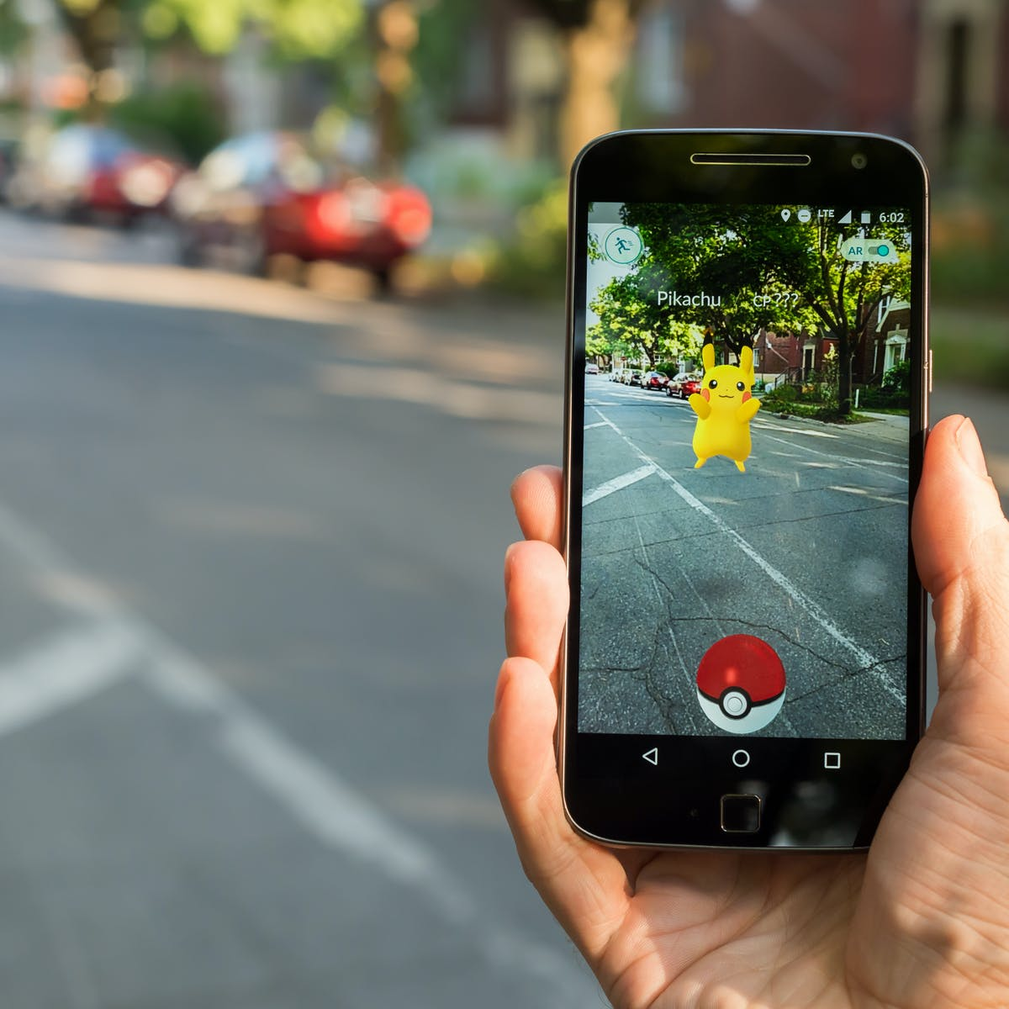
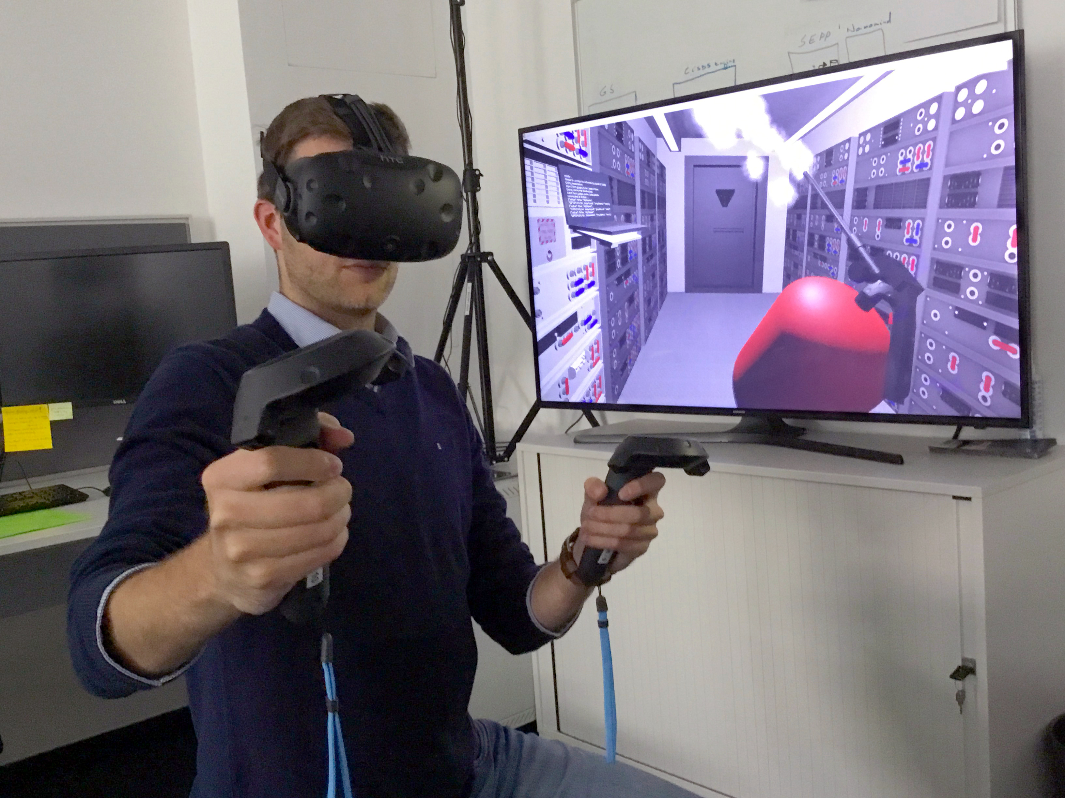
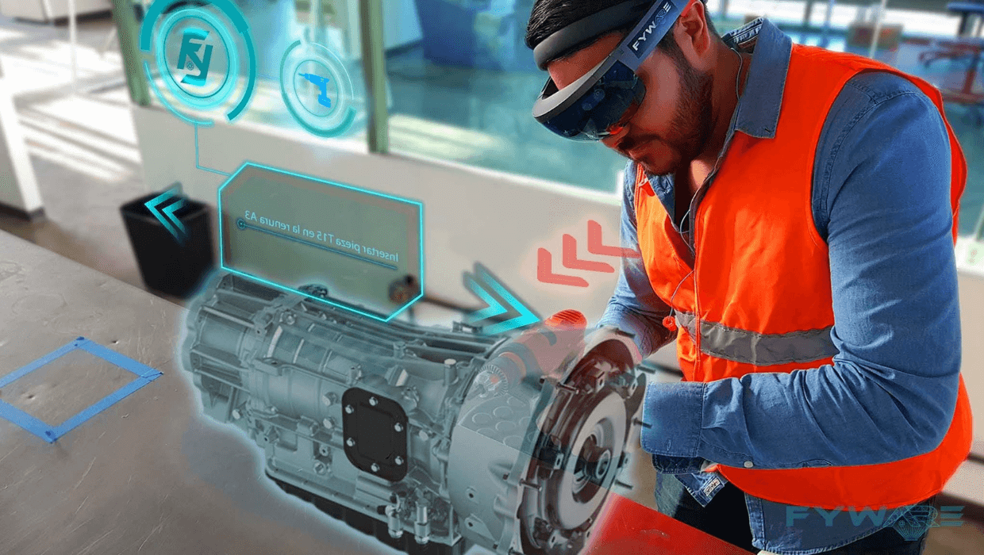
You , me, objects,
etc.
0’s 1’s, any digital signals
“Image, Video, 3D ,etc.”
Image Source : Google

Slide 5
Section 2. Brief discuss about AVT Time :3 min Slide(s) : 3

Slide 6
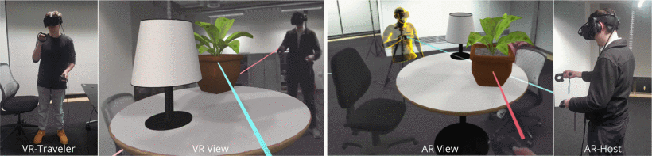
Concept of Augmented Virtual Teleportation(AVT)
Image Source : AVT (Base paper)

Slide 7
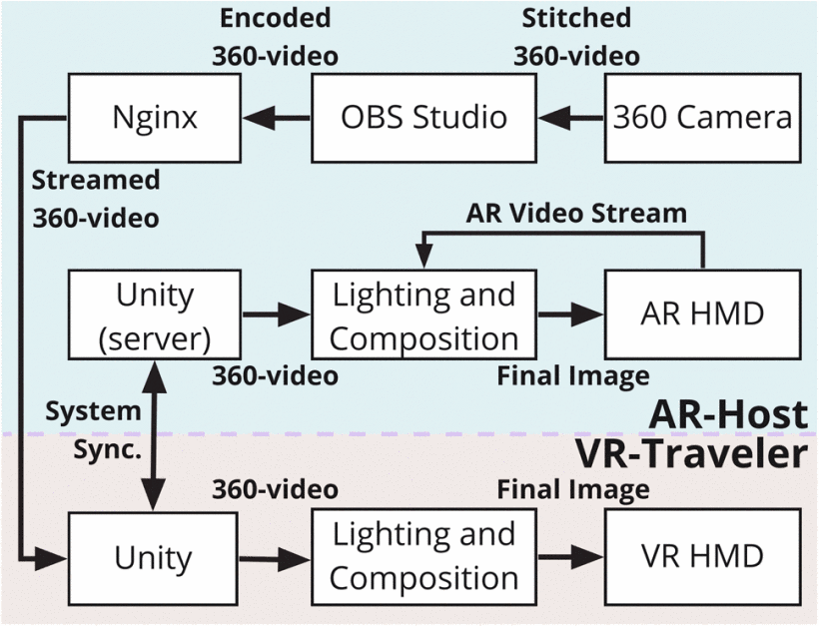
Technical Architecture of AVT
Image Source : AVT (Base paper)

Slide 8
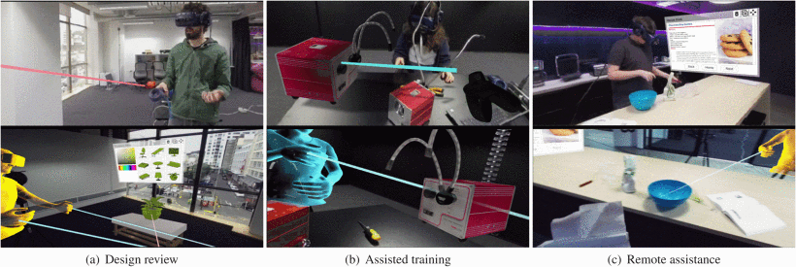
Few Applications proposed by AVT
Image Source : AVT (Base paper)

Slide 9
Section 3. Limitation of AVT Time :2 min Slide(s) : 2

Slide 10
360 camera Solution for Teleportation
- “Creating a high-fidelity, real-world environment in is challenging, thereby limiting a high VR through 3D reconstruction sense of presence in live telecollaboration. One recent viable solution to this problem is using 360° capturing cameras and videos (360-camera/video) in VR scenarios, which has been shown to provide a high sense of presence. ”
Major Limitation by this technique:
360 is 3DOF VR.
So, You cannot Walk inside Teleported area.
Hence, Less immersive.
Source : AVT (Base paper)

Slide 11
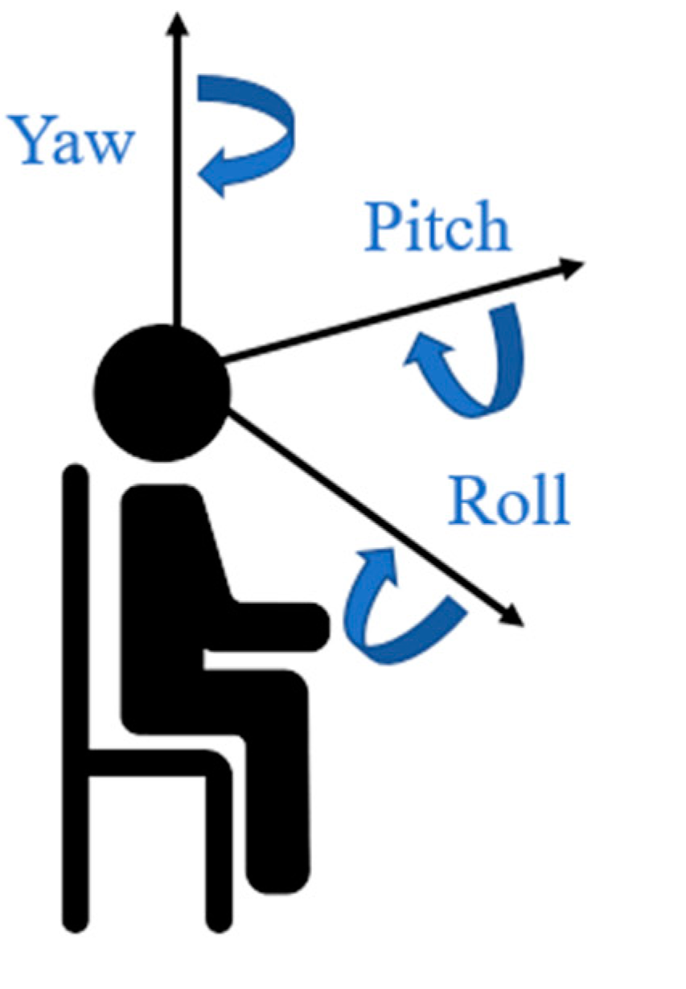
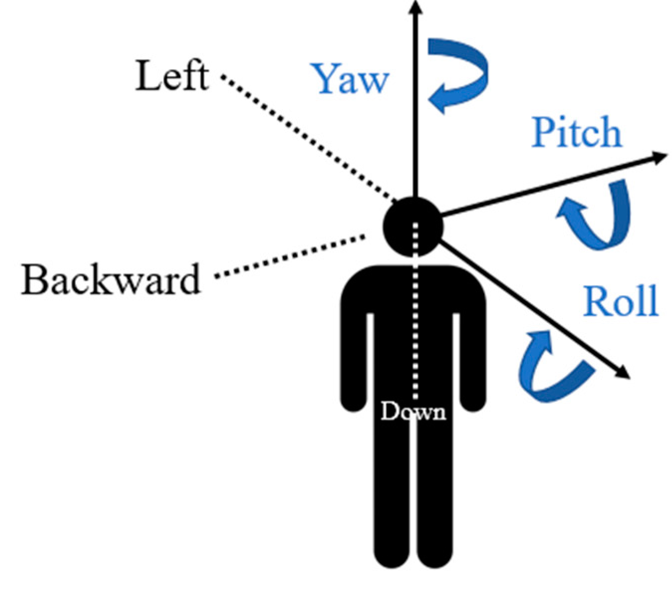

3DOF vs 6DOF
3 DOF
6 DOF
Vimal Kumar

Slide 12
Section 4. Overcoming with Solutions Time :5 min Slide(s) : 7

Slide 13

New Proposed model
Place A - Virtual Reality (VR)
Place B - Augmented Reality (AR)
HMD AR device
VR display
Design Object + Place B View
3D Reconstruction of
Place B & Design Object
Vimal Kumar

Slide 14
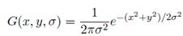
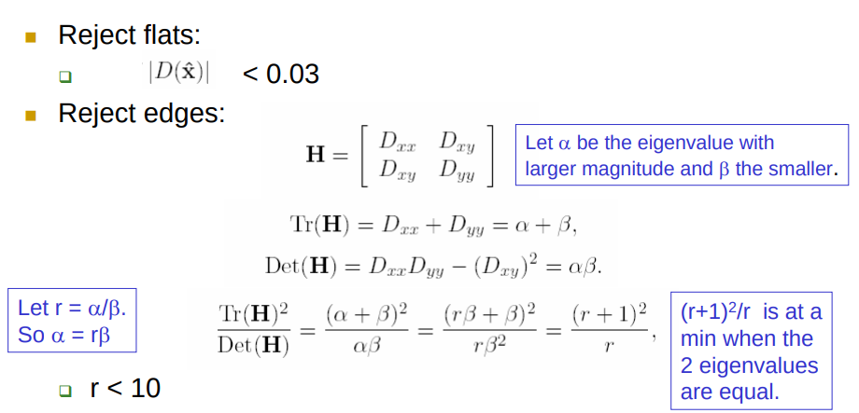
Technique for Augmented Reality view (concept unchanged from AVT)
Feature Tracking Algorithms:
Brief on SIFT Algorithm:
Step 1 : Scale-space peak selection: Potential location for finding features of blurred image. Here we are using difference of Gaussian (DoG).
Step 2 : Key point Localization: Accurately locating the feature key points.
Step 3 : Orientation Assignment
Making rotation invariance using histogram matching.
Step 4 : Key point descriptor
Viewpoint and illumination comparison with neighbours.
Step 5 : Key point Matching
matched by identifying their nearest neighbors.
SIFT
SURF
FAST
ORB
.
.
.
.
.
.
SLAM

Slide 15
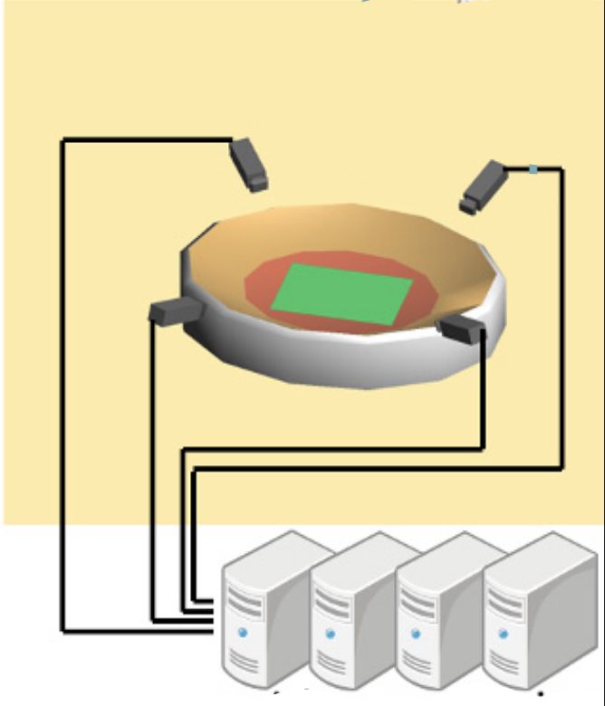
Technique for Free viewpoint video(FVV) (For 6DOF FVV is required)
Scene recognition
Data Processing
Reconstruction Geometry for VR
Video Application
Silhouette extraction from moving object
Reconstruct 3D shapes from silhouette extraction
6DOF
VR devices
Signal Processing of overlapped video signals
Create Virtual path Geometry
Camera placement
Auto Calibration
Auto Object tracking
Data Compression
Data Transfer via high Bandwidth channel
Vimal Kumar

Slide 16
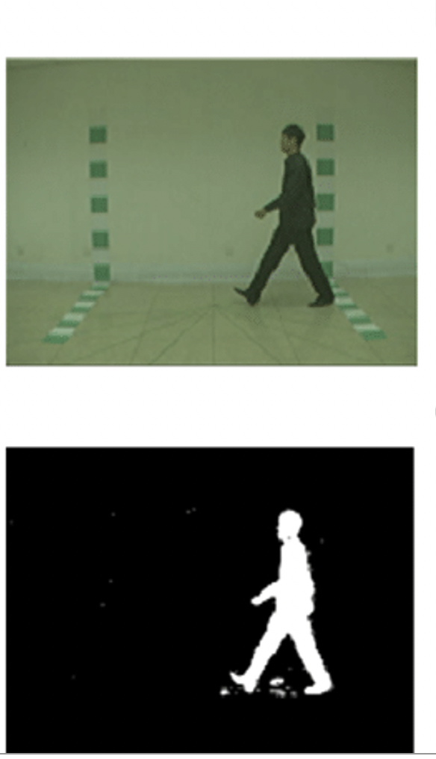
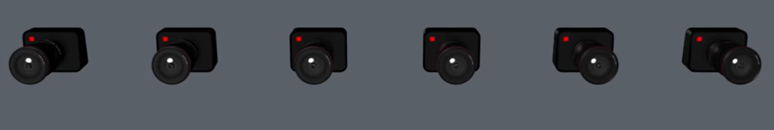
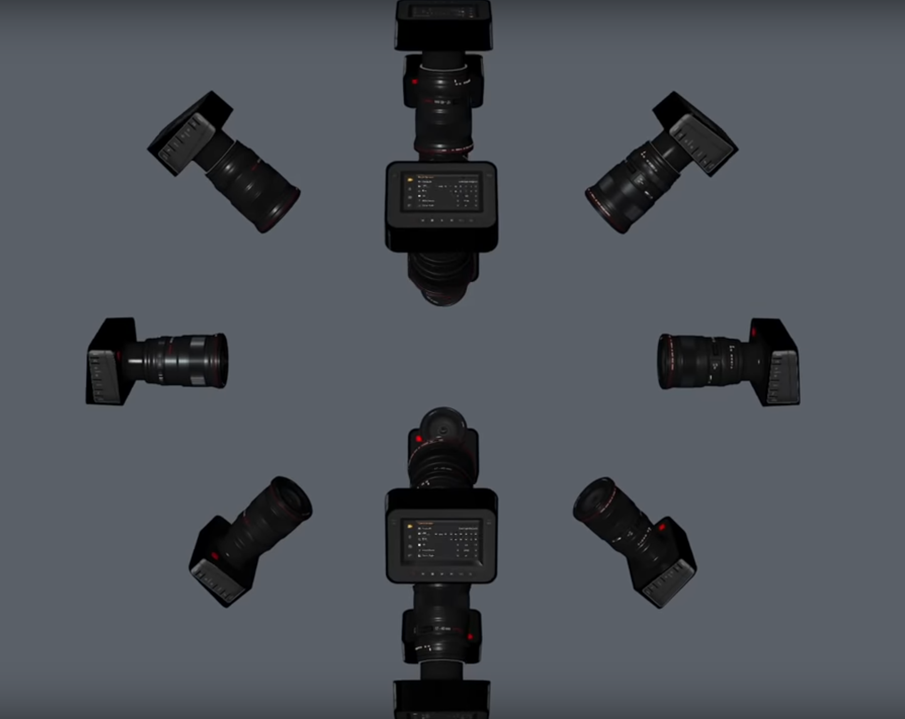
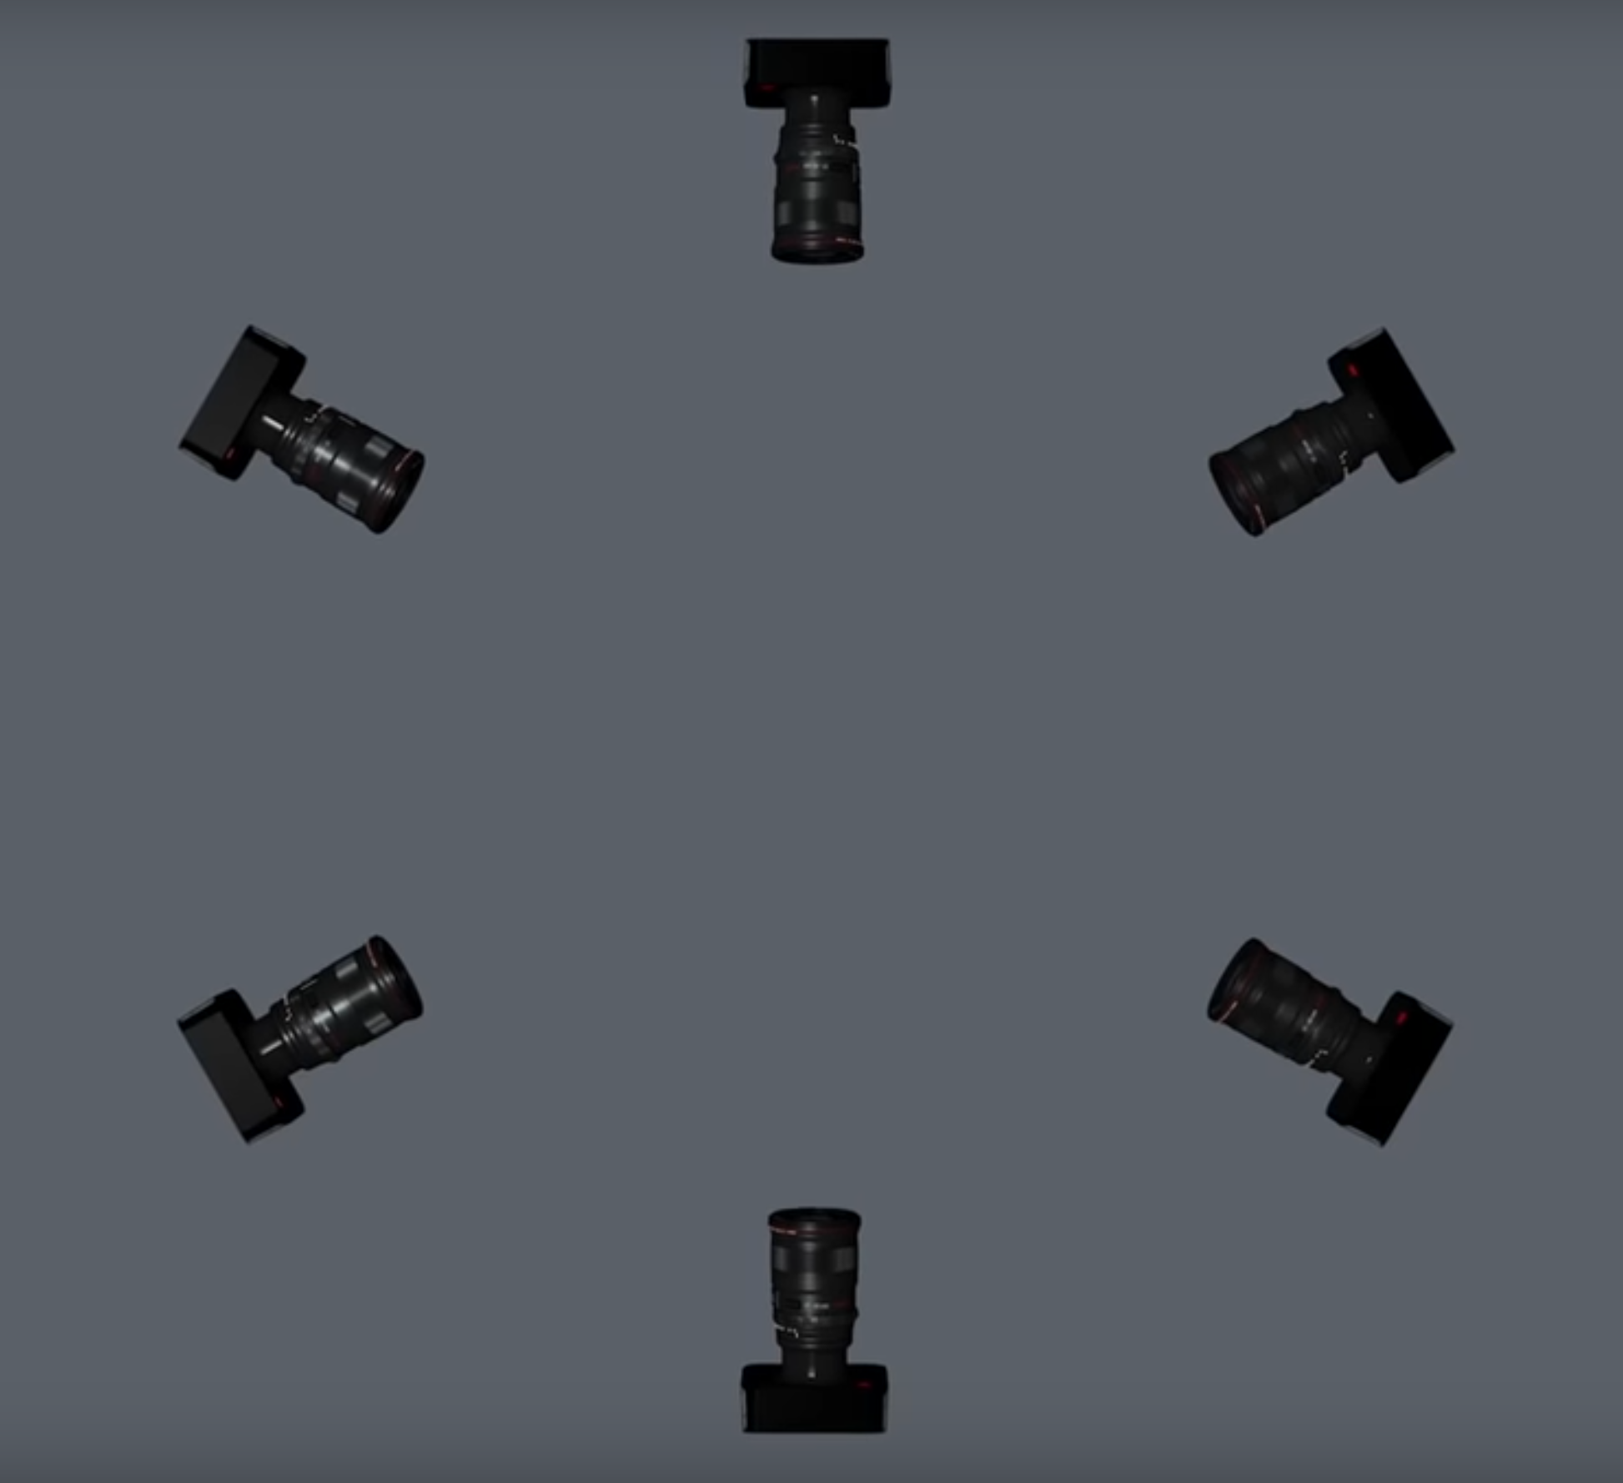
Object coverage through Camera Arrangement
Object extraction
1. Linear
3. Spherical
2.Circular
Vimal Kumar

Slide 17
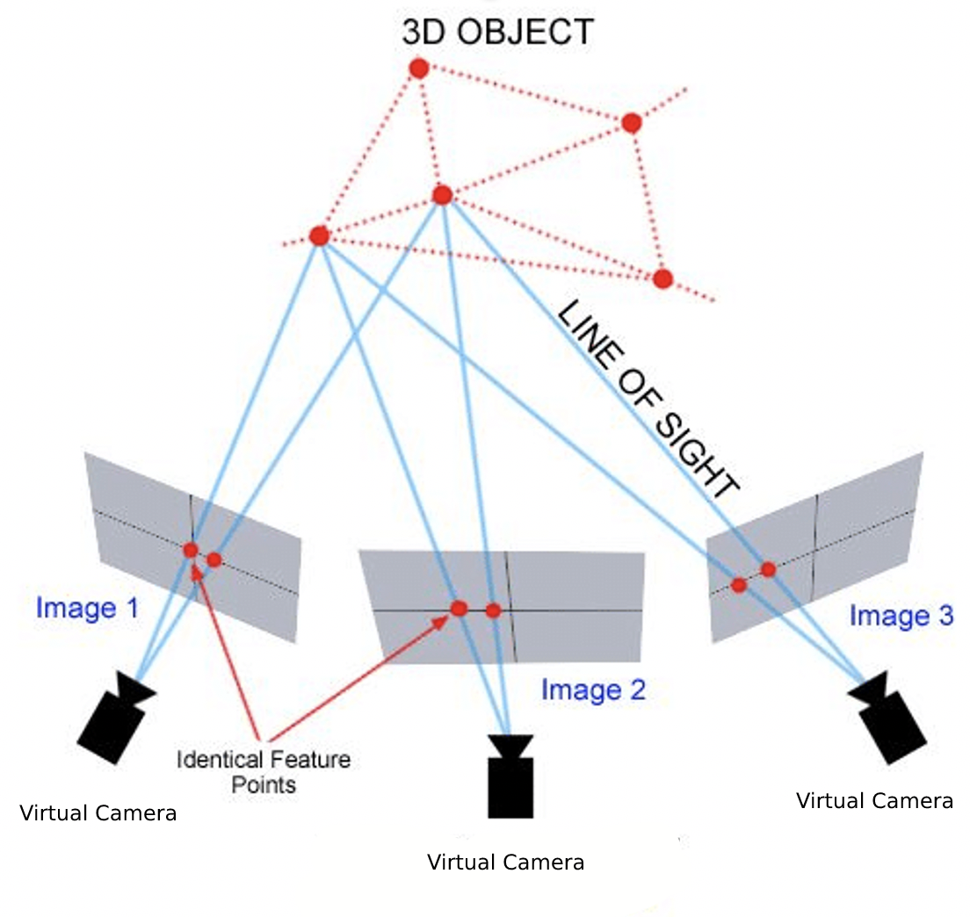
3D Reconstruction & Final rendering
This process of 3D construction from photos/videos is called Photogrammetry / Videogrammetry.
Vimal Kumar

Slide 18
Technique for Virtual Reality (concept changed 3DOF to 6DOF)
Input : 3D points generated after Data processing
Step1 : Mesh generation from 3D points is done by Polygon filling Algorithms:
Scanline algorithm
Boundary fill algorithm
4 connect or 8 connect algorithm / Flood Fill algorithm
Step 2 : Texturing
Step 3: Compositing (optional)
Step 4: Lightning (optional)
Step 5: Rendering into VR (happens in device part)
Vimal Kumar

Slide 19
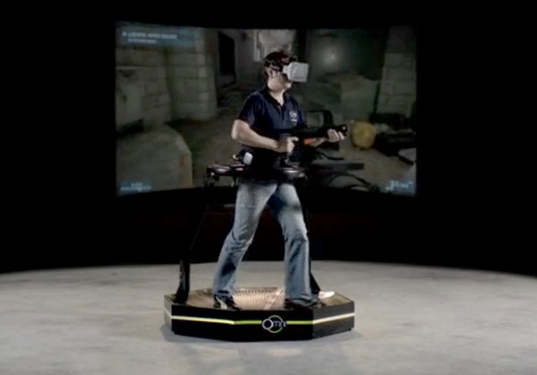
Limitations from newly stated solutions
You can walk now in VR
So don’t get hit by the walls
Other limitations:
Require higher Bandwidth
Latency
Costly hardware
Image Source : Google

Slide 20
Section 5. Demo Time :2 min Slide(s) : 3

Slide 21
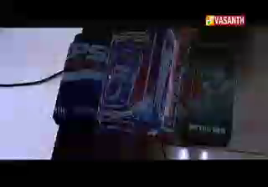
AR Demo

Slide 22
Free View Point Demo

Slide 23
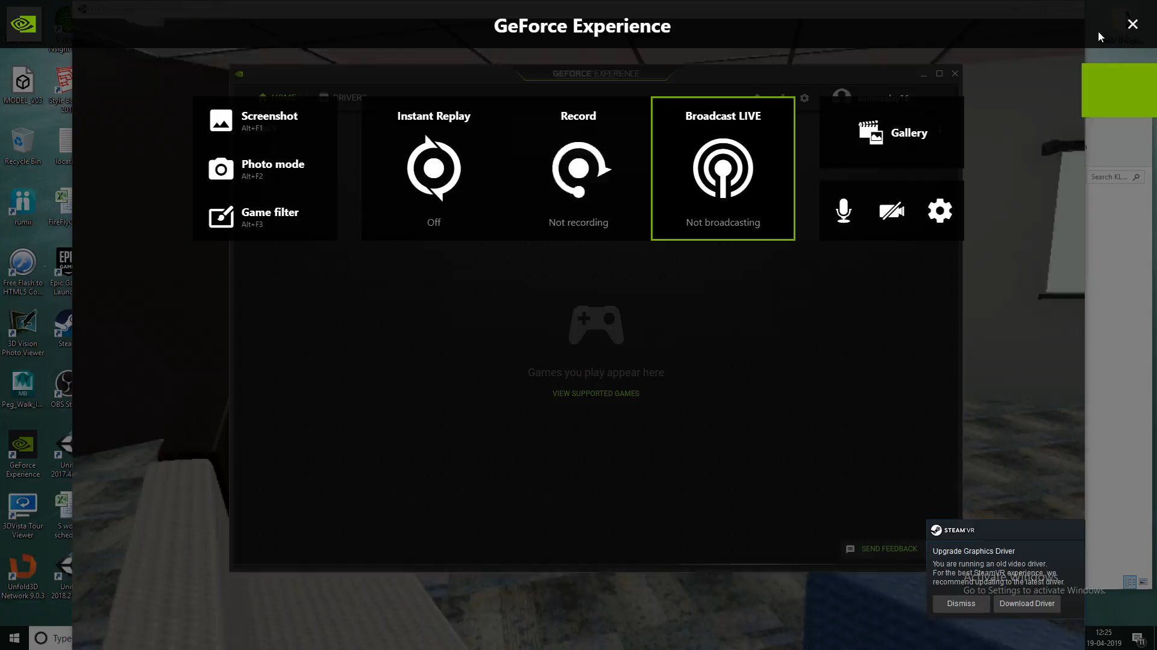
6 DOF VR

Slide 24
References
Key and Idea from
Free view point concept
Real-virtual continuum
Title : Augmented Virtual Teleportation for High-Fidelity Telecollaboration
Published in: IEEE Transactions on Visualization and Computer Graphics ( Volume: 26, Issue: 5, May 2020)
Page(s): 1923 - 1933
Date of Publication: 13 February 2020
ISSN Information:
Print ISSN: 1077-2626
Electronic ISSN: 1941-0506
CD: 2160-9306
PubMed ID: 32070972
INSPEC Accession Number: 19494078
DOI: 10.1109/TVCG.2020.2973065
Publisher: IEEE
Title : Free-Viewpoint TV
Published in: IEEE Signal Processing Magazine ( Volume: 28, Issue: 1, Jan. 2011)
Page(s): 67 - 76
Date of Publication: 17 December 2010
ISSN Information:
Print ISSN: 1053-5888
Electronic ISSN: 1558-0792
INSPEC Accession Number: 11698346
DOI: 10.1109/MSP.2010.939077
Publisher: IEEE
Title : Augmented reality: a class of displays on the reality-virtuality continuum
Event: Photonics for Industrial Applications, 1994, Boston, MA, United States
Published in: Proceedings Volume 2351, Telemanipulator and Telepresence Technologies; (1995)
Date of Publication: 21 December 1995
DOI: https://doi.org/10.1117/12.197321
Publisher: SPIE

Slide 25
Q & A

